Slide 1
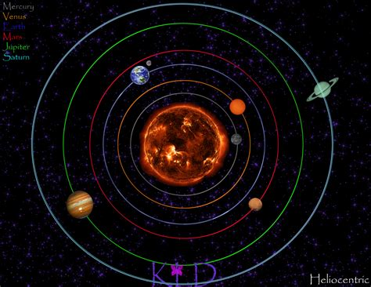
Solar System Models – Page 1
Long, long ago, way before you and I were born, people thought that the Earth was right in the center of the entire Universe! Wild, right? They believed everything - the bright Sun, the glowing Moon, the twinkling stars, and the other mysterious planets - all danced around our Earth, like fans cheering for their favorite star. This idea is called the "geocentric" model. "Geo" is a prefix that means Earth and "centric" means in the center. But guess what? Things were about to change. Brilliant minds like the scientist Copernicus were gearing up to shake up these ideas big time!
What did people think was at the center of the Universe long ago? ___________________________________________________________________
What do “geo” and “centric” mean? ___________________________________________________________________
Who was a scientist who started to change these ideas? ___________________________________________________________________ ___________________________________________________________________
Say hello to the "heliocentric" model! This groundbreaking idea placed the shiny, blazing Sun at the center with all the planets, including our Earth, spinning around it like tops. "Helio" is a cool prefix that means Sun. This was a huge deal! Suddenly, our home planet wasn’t the superstar anymore. A scientist named Copernicus was one of the brave thinkers to suggest this, and later, Galileo used his super powerful telescope to make observations that backed it up. Boy, did the universe suddenly seem bigger, grander, and more mysterious!
What is the “heliocentric” model? ___________________________________________________________________
What does “helio” mean? ___________________________________________________________________
How did Galileo support the heliocentric model? ___________________________________________________________________

Slide 2
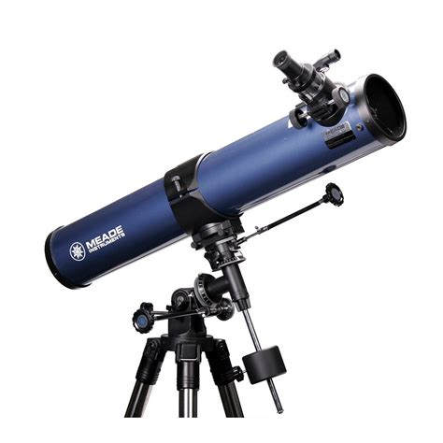
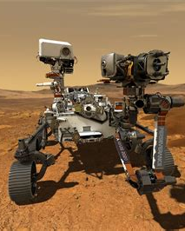
Solar System Models – Page 2
But hold on, the space adventure didn't hit the brakes there! As time ticked on, we stumbled upon more and more planets. The beautiful blue Uranus, the deep-blue Neptune, and even the icy dwarf planet Pluto were discovered! Before this, people only knew about six planets. Our telescopes, like giant cosmic binoculars, got better and better, letting us see farther and clearer into the mysterious expanse of space. With each new discovery, our view of the solar system grew and expanded.
What are planets? __________________________________________________________________
How many planets are there in our family photo of the solar system? __________________________________________________________________
Why don’t planets have cotton candy clouds? __________________________________________________________________
Fast forward to the present, we've done some pretty amazing things. We've sent super-smart robots called rovers and satellites beyond the Earth, to places we've never been before. These awesome machines travel to distant, otherworldly planets and moons. They're our cosmic postmen, sending back mind-blowing pictures and fascinating information that we could only dream about in the past. Thanks to these machines, we've learned about the rocky surface of Mars, the enormous swirling storms on Jupiter, and the intricate icy rings that circle Saturn. Every new snapshot and piece of data helps us understand our vast cosmic neighborhood better.
What is a moon? __________________________________________________________________
Can you name a planet with more than 60 moons? __________________________________________________________________
Just how many moons does Jupiter have? __________________________________________________________________

